Slide 1








Psychological First Aid
for Staff
School Mental Health
Student Health & Human Services

Slide 2

Forget your perfect offering, there is a crack in everything. That is how the light gets in.
Leonard Cohen

Slide 3

Core Rights
The world is a safe place.
I can trust others.
I am competent.

Slide 4














Psychological First Aid
Protect
Model
Listen
Connect
Teach

Slide 5


Listen
Address behaviors/concerns/feelings, as soon as possible.
If an individual wants to talk, be prepared to listen.
Focus on what they say and how you can be of help.
Observe and acknowledge nonverbal communication.
Individuals may also show their feelings in nonverbal
ways, such as a significant change in behavior or
mood.
Express compassion and calmness in your voice and body language.
Give yourself the same grace and compassion that
you demonstrate to others.

Slide 6



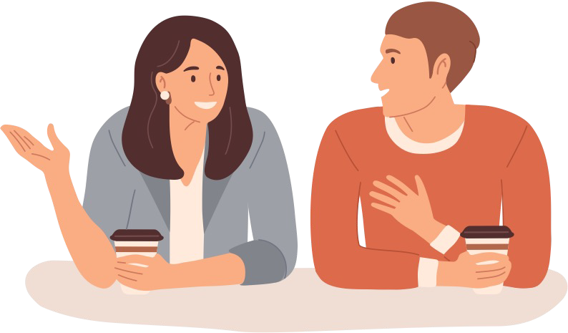
Implementing Listen
Ask questions about a person’s
well-being when you have time to listen attentively
Make time to reach out and listen
I noticed...how are you doing?

Slide 7

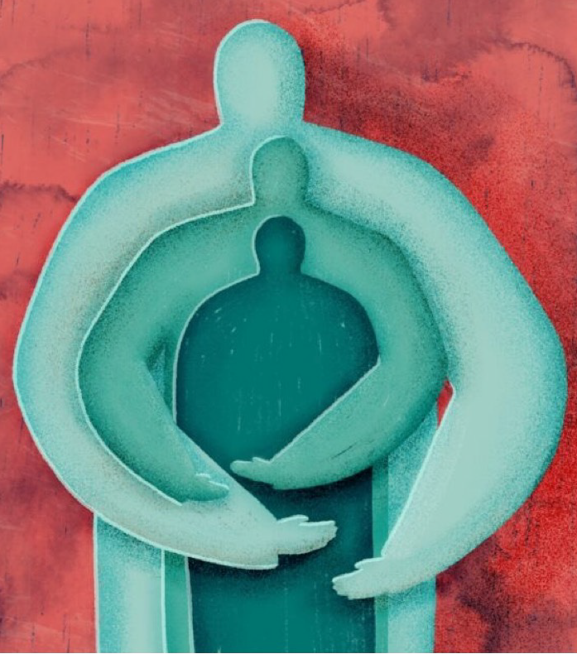
Protect
Maintain daily routines, structure, and clear expectations of yourself and others.
Exhibit consistency to encourage successful
outcomes.
Ensure accurate information and do your best not to engage in gossip or hearsay.
Do what you can to keep the environment free of
anything that could re-traumatize yourself or others.
Validate yours and others life experience.
Maintain confidentiality, as appropriate.
Protecting yourself is about getting enough sleep, eating well, exercising your body and mind, as well as leaning on trusted friends, relatives, and support systems.

Slide 8



Implementing Protect
What are you most worried about right now?
(Paraphrase) What I heard you say was...
It sounds like you have several questions that need to be addressed.

Slide 9

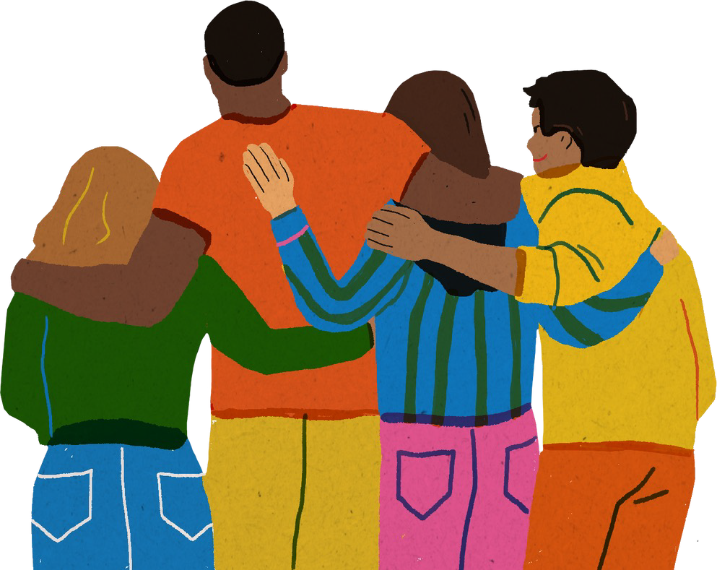
Connect
Establish community and connection in the workplace.
Encourage interactions, activities, and team projects.
Become familiar with the resources to
support adult well-being.
Maintain regular contact with your compassionate support network.

Slide 10



Implementing Connect
Incorporating team building activities in the workplace
Post resources to support employee wellbeing in common areas
What can I do to help?
What can your friends do to help?
What do you think you can do to make things better?
What has been helpful to you in the past when you’ve faced the situation?

Slide 11
What Not to Say & What To Say
Avoid saying this…
I know just what you’re going
through.
This is hard, but it is important to
remember the good things in life,
too.
You must be incredibly angry.
You’ll need to be strong now for
your family. It’s important to get a
grip on your feelings.
Say this instead…
• Can you tell me more about what this has been like for you?
• What sorts of things have you been thinking about since...
• Most people have strong feelings when something like this happens to them. What has this been like for you?
• How is your family doing? What kinds of concerns do you have about them?
Adapted from What Not to Say from the Coalition to Support Grieving Students

Slide 12


Model
Model healthy responses by remaining calm, courteous, organized, and helpful.
Pay attention to your thoughts, feelings, and actions, as they may influence how an individual responds.
Take constructive actions to assure safety.
Acknowledge the difficulty of the situation.
Find the opportunity to replenish your own
resources, by practicing self-care and encourage others to do so.

Slide 13
Implementing Model
Thank you for the courage you’ve shown and for sharing your concerns with me.
Let’s talk about some things you can do to connect with others.
Demonstrate how you take care of
yourself (i.e., leaving work on time, eating, taking designated breaks)

Slide 14


Teach
Individuals may have different reactions to the same event.
Encourage one another to identify and use positive coping strategies to help them after the event.
Help individuals identify the people in their personal and professional compassionate support network.
Set small “doable” goals and share in these achievements as “wins.”

Slide 15
Implementing Teach
Validate their feelings regardless of whether or not you agree with their perspective.
Stressful incidents like this can sometimes interrupt our routine. Let's talk about ways to get back on track.
You don’t have to handle this on your own. Let’s talk about who are some people in your personal and professional compassionate support network.

Slide 16


Let’s Practice
Sam is outgoing and charismatic. They come into work with a positive attitude, and a friendly greeting for everyone. Today, they show up to work late, disheveled, and quiet. A colleague notices and mentions Sam’s presentation to you.
What are your next steps?
Do you talk to Sam?
What would you say to Sam?
What resources would you provide Sam?
Are there any additional steps that need to be taken?

Slide 17



Let’s Practice
I noticed...how are you doing?
What happened?
What are you most worried about right now?
(Paraphrase) What I heard you say was...
What can I do to help?
What can your friends do to help?
What do you think you can do to make things better?
What has been helpful to you in the past when you’ve faced the situation?
Thank you for the courage you’ve shown and for sharing your concerns with me.
Let’s talk about some things you can do to connect with others.
Stressful incidents like this can sometimes interrupt our routine. Let's talk about ways to get back on track.
You don’t have to handle this on your own. Let’s talk about who are some people in your compassionate support network.
What would you say to Sam?
What resources would you provide Sam?
Are there any additional steps that need to be taken?

Slide 19




Slide 20



Slide 21

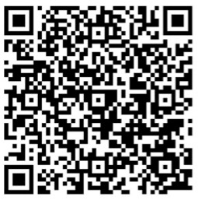
School Mental Health I Student Health & Human Services
PROFESSIONAL DEVELOPMENT FEEDBACK
Make sure you are signed into your LAUSD email account
Date of the professional development/training you
attended: XX/XX/2024
Title of the professional development/training opportunity
you attended: PFA for Staff
EVALUATION LINK:
https://forms.office.com/r/kQUz9SUYw8
Thank you!

